Slide 1

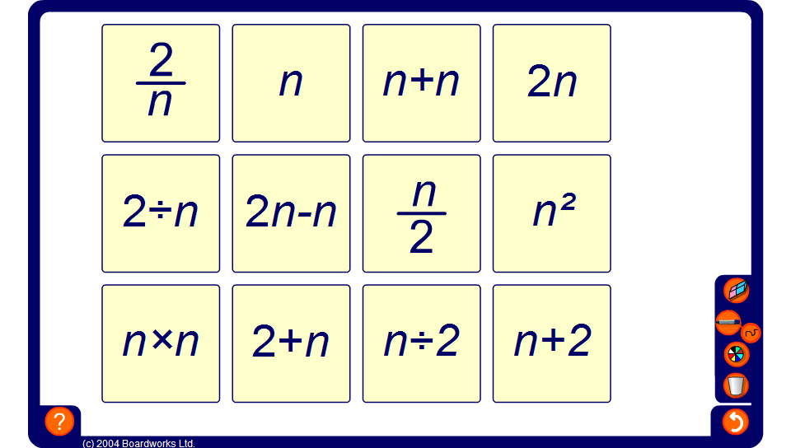


Equivalent expression match

